Slide 1

Spotted Python Week 2 Tutorial
Markdown
Modules
Lists and Arrays

Slide 2

Markdown
Text-to-HTML conversion tool
Can be used in Jupyter Notebooks for annotation of code
Allows mathematical expressions in LaTeX-style syntax
Cheat sheet: https://www.markdownguide.org/cheat-sheet/
Complete Exercise 1
Element | Markdown Syntax
Heading | # Heading 1
Bold | **Bold text** or __Bold text__
Italic | *Italic text* or _Italic text_
Highlight | ==Highlighted text==
Unordered List | - First item
Link | [title](https://www.example.com)

Slide 3
BODMAS with Python
Operators in Python are applied much like the rules we learnt in primary school. Specifically:
() Brackets
** (not ^) Exponentiation
*, /, //, % Multiplication, Division, Floor Division, Modulus
+, - Addition, Subtraction
Complete Exercise 2
Note:
Using comments and easily interpreted variable names makes code easier to read. But make sure your variable name starts with a letter and is not a reserved word within Python.

Slide 4


Modules
A file containing Python definitions and statements that can be imported into another script
Common modules and how they are imported:
import numpy as np
Manipulation of arrays
import matplotlib.pyplot as plt
Create static, animated and interactive visualisations
from astropy.io import fits
Contains range of tools for astronomical computations
FITS (Flexible Image Transport System) is a digital file format containing multi-dimensional arrays

Slide 5
Data Types
A file of different data types:
Cannot add or subtract strings with an integer
To work with the data types, you can convert them into the same type
Data Type | Meaning
Integer | No decimal point
Floating point | With decimal
Complex number
String | Text

Slide 6
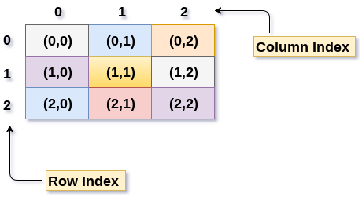
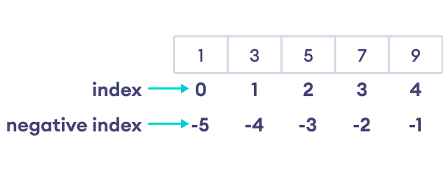
Lists and Arrays
Lists are a sequence of objects enclosed in [ ] and separated by commas
Arrays are an arrangement of numbers or objects formatted into rows and columns
Indexing:
Complete Exercise 3
Notice that indexing starts from 0

Slide 7
Group Meeting Time

